Slide 1
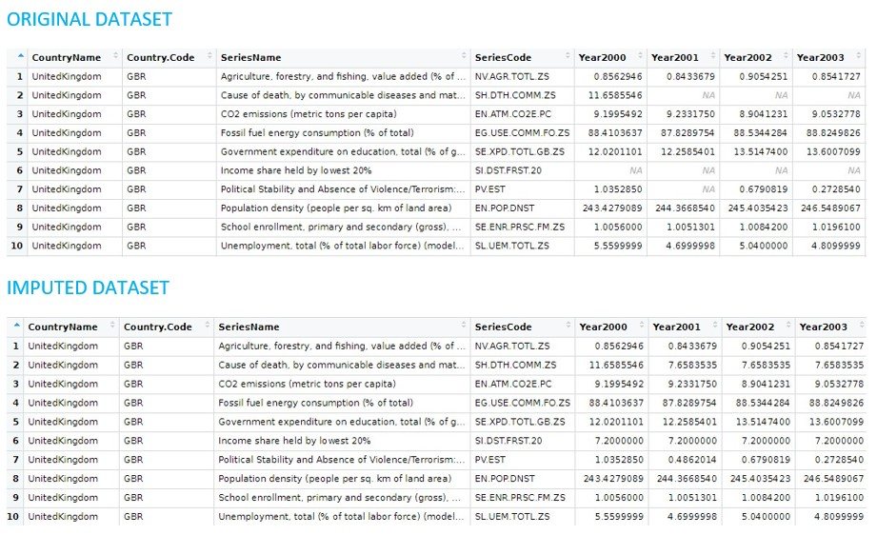
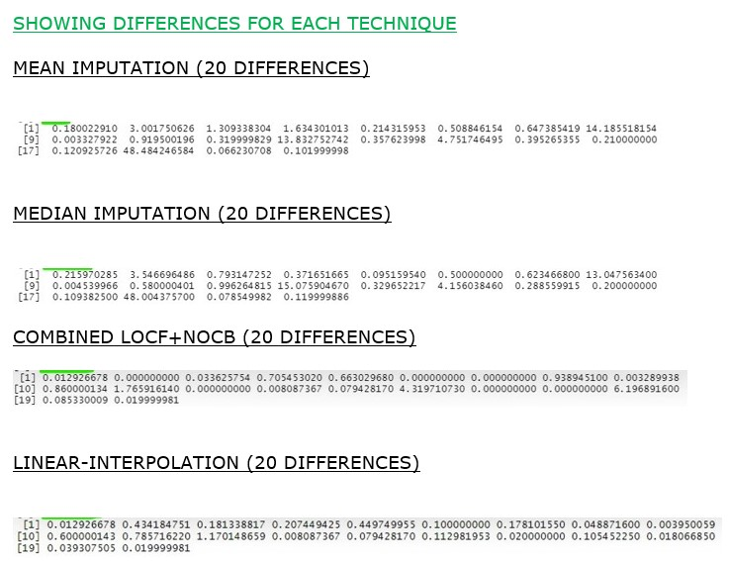
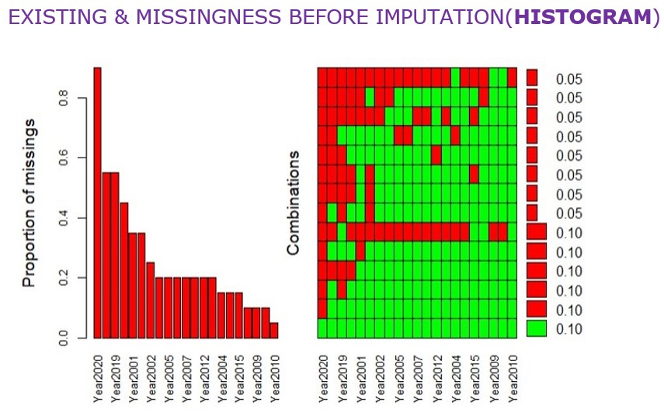
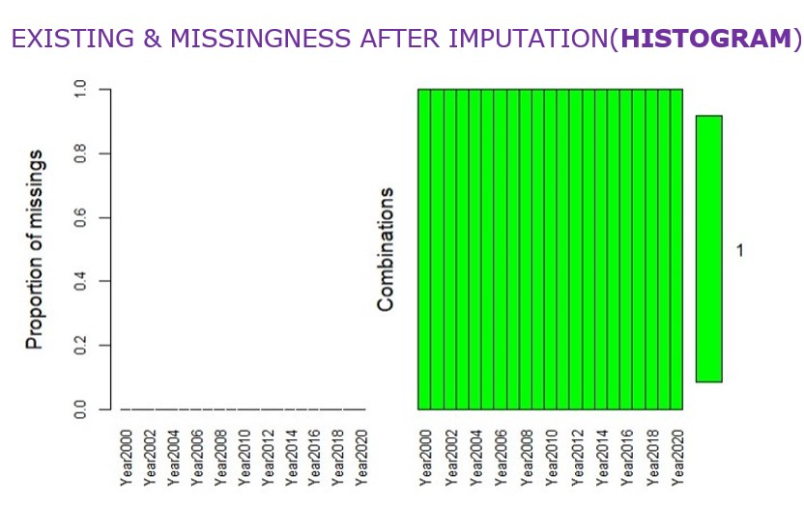
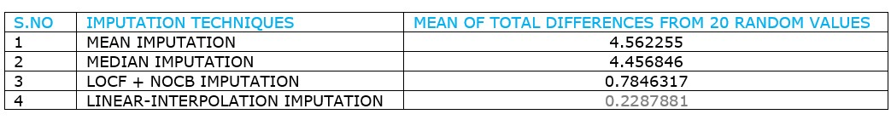
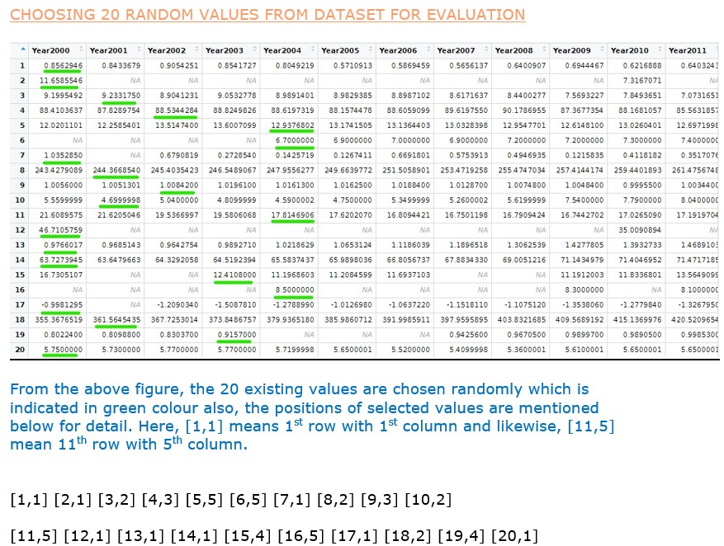
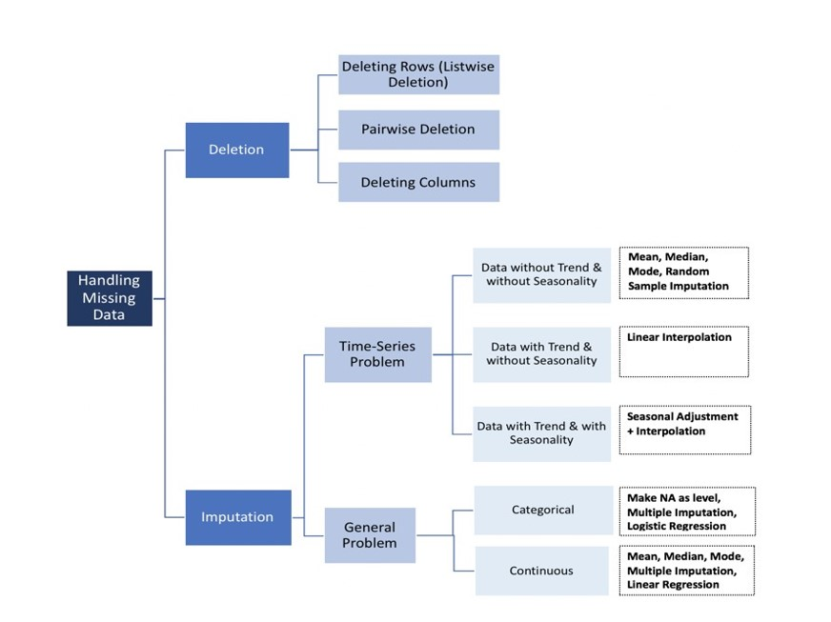
WHAT’S THE BEST METHOD TO
ESTIMATE MISSING ETHICS DATA?
^{Surendran Lokbahadur}
Introduction
Figures and Results
Conclusion
ESG is the combined information of Environmental, Social, Governance and it captures issues such as their greenhouse gas emissions, wealth inequality, and gender workforce balance amongst dozens of other aspects also, these can be thought of as ethical scores of a country(WORLD BANK DATA, 1944). The data sets that have been collected or chosen from ESG contains a lot of missing, so we need a way to estimate the missing values.
This project mainly involves with three different sections. The first section has design which elaborates about each of the chosen techniques in detail also, the advantages and disadvantages for each one technique. Secondly, it is about implementation and this section involves the types of missing values and different filling methods also, the variety of coding techniques has been used for the chosen data handling techniques to show the difference between each technique. The final section is about evaluating the opted techniques by comparing with each other methods to recommend the best one.
figures
figures
figures
figures
As per the practical-proof shown in the implementation & evaluation, the specific technique called ‘Linear-Interpolation’ has the least or nearest values in majority when compared to other mentioned techniques, so it is the better technique for handling the missing data.
Finally, it has been proved from the total-differences & mean estimation for each technique in that the ‘Linear Interpolation’ is the best technique for missing data handling in order to achieve the better results.
Project Aim
From the above figure contains ‘Original dataset’, we can see it is the pre-processed data contains only 10 different factors which has combination of ESG data and the main reason for choosing those specific factors is to show balancing ‘existing & missing data’ for better results.
Furthermore, from the above picture contains ‘Imputed dataset’, we can see the missing values are replaced with the help of opted techniques like Mean Imputation, Median Imputation, Last observation carried forward(LOCF), Next observation carried backward(NOCB), Linear Interpolation also, each of the technique has ‘R coding’ and ‘ data filling’ speciality.
Additionally, we can see from the above diagram contains ‘Histogram plot’ before and after the data imputation also, the red colour indicates missing data and green colour with filled data.
To find the best method of imputing different Environmental, Social and Governance (ESG) measures for missing data.
Research the background of Environmental, Social and Governance (ESG) measures. Next, research techniques for imputing missing data. Also, Collect and pre-process a suitable dataset of ESG factors for a set of countries. Furthermore, measure the effectiveness of standard data imputation methods to estimate data. Additionally, implement additional imputation methods that depend on domain-specific knowledge.
Acknowledgments
I would like to thank my supervisor Dr. Mark Bartlett for his guidance, Support, collaboration and valuable advice throughout the duration of the project. By virtue of this experience, there has been a marked improvement in my research, writing and software development skills.
The School of Computing Science has greatly impacted my career advancement with the solid foundation provided through their delivery of modern industry-relevant subject matters.
Methods
figures
figures
References
WORLD BANK DATA, T., 1944. Environmental, Social and Governance data, NW, Washington, DC. [online] THE WORLD BANK. Available at: <https://www.worldbank.org/en/home>.
A, S., 2020. Data Imputation Techniques, Tamilnadu, India. [online] Linkedin.com. Available at: <https://www.linkedin.com/pulse/data-imputation-techniques-sakthivel-a>
VIDVAN, T., 2022. R programming, London, UK.[online]techvidvan. Availableat:<https://techvidvan.com/tutorials/pros-and-cons-of-r/>
CHOSEN TECHNIQUES (A, S., 2020)
Mean Imputation - Missing data is replaced by mean of the existing data.
Median Imputation - Missing data is replaced by the centre value when arranged numbers from lowest to highest.
LOCF - Missing data is replaced by last observation carrying data.
NOCB - Missing data is replaced by next observed carrying data.
LINEAR INTERPOLATION- Missingness is replaced by interconnecting existing values
Moreover, we are going to delete all the selected 20 existing values and replacing the deleted values by ‘na’ then imputing the ‘na’ values & finding the difference between ‘existing values and imputed values’ also, the process is continued till we find the difference for all the 20 chosen random values. Also, after finding the difference for all the 20 selected random values the mean is calculated at the end then it is repeated for all the 4 techniques.
Finally, the 20 differences calculated from the chosen random values and the estimated mean are compared with each other techniques to find the best technique which has a least or nearest value.
MSc IT for the Oil & Gas Industry
Supervised by Dr. Mark Bartlett

